Slide 1
UFCEP6 0 3
Release 2 Integrated
Hospital Patient Pathway
Operational BPMN, Camunda Forms, external workers and persistence
Submission package includes presentation, evidence documents, executable BPMN, forms, worker source and run instructions.
20 October 2026

Slide 2
UFCEP6 0 3 Release 2
02
Release 2 system scope
Referral
Appointment
Finance
Treatment
Enquiry and letter
Validate referral and record consultant decision
Search slots, confirm contact and handle exceptions
Determine funding, payment or refund and clearance
Assess treatment, review cycle and record actions
Route enquiries, approve letters and monitor follow up
The executable Hospital Master Process coordinates all five child BPMN processes.
Supporting evidence: 02_Release2_Integrated_BPMN/00_Integration/Hospital_Master_Process.bpmn

Slide 3
UFCEP6 0 3 Release 2
03
Response to tutor feedback
Form validation
Required fields and conditional choices
All critical forms use validation
Merging gateways
Converging gateways and controlled retry loops
Clearer path rejoining
Scenario coverage
New action and exception forms
Referral, appointment, treatment, enquiry and letter cases
Data persistence
H2 repository with load and save behaviour
Data can be retrieved by application identifiers
Supporting evidence: 05_Evidence_Documents/Teacher_Feedback_Implementation_Evidence.docx

Slide 4
UFCEP6 0 3 Release 2
04
Forms and operational validation
Form improvements
Operational checks
24 Camunda form definitions grouped by process owner
Task to form bindings are consistent
Required inputs and bounded options for decisions and outcomes
All child BPMN flow references pass validation
Added exception forms for referral action, appointment resolution, treatment action, enquiry route and clinic letter administration
Normal and exception scenarios can be demonstrated through the master process
Supporting evidence: 03_Camunda_Forms and 02_Release2_Integrated_BPMN

Slide 5
UFCEP6 0 3 Release 2
05
External workers and data persistence
1
2
3
4
5
Form and process variables
Worker receives job
Repository loads and merges application record
Repository saves updated state
Process continues with persisted status
ApplicationDataRepository provides embedded H2 persistence for patient, referral, appointment, finance and treatment data.
Supporting evidence: 04_External_Workers/src/main/java/org/hospital/workers/ApplicationDataRepository.java

Slide 6
UFCEP6 0 3 Release 2
07
Project plan evaluation
Initial plan
Actual progress
Revised plan
Remaining evidence
Operational process decomposition and base forms
Implemented child processes, integration and executable worker logic
Tutor feedback drove validation, gateways, missing form options and persistence work
Capture final user interface screenshots for normal, exception and persisted data retrieval paths
Supporting evidence: 05_Evidence_Documents/Plan _Test_Results.docx

Slide 7
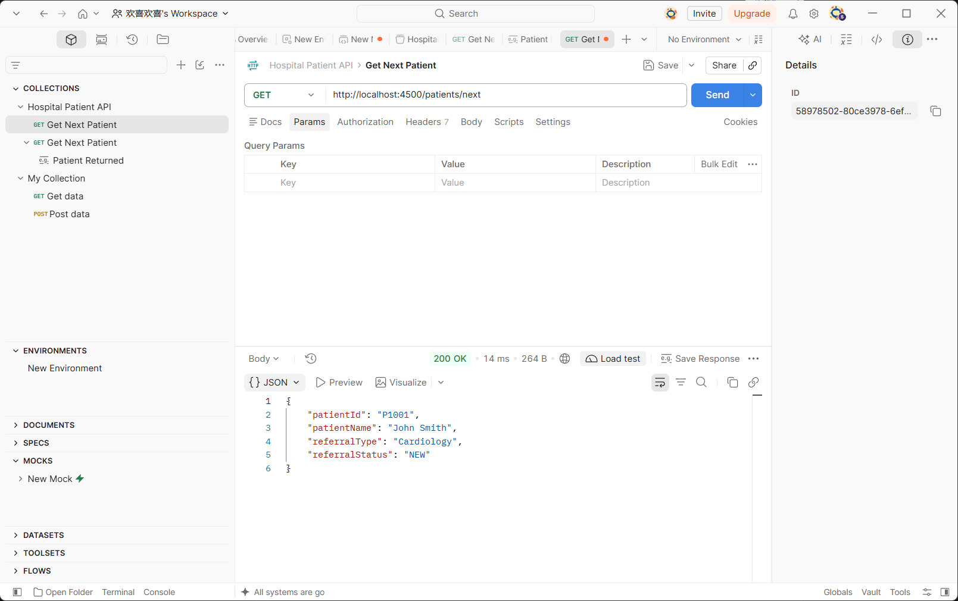
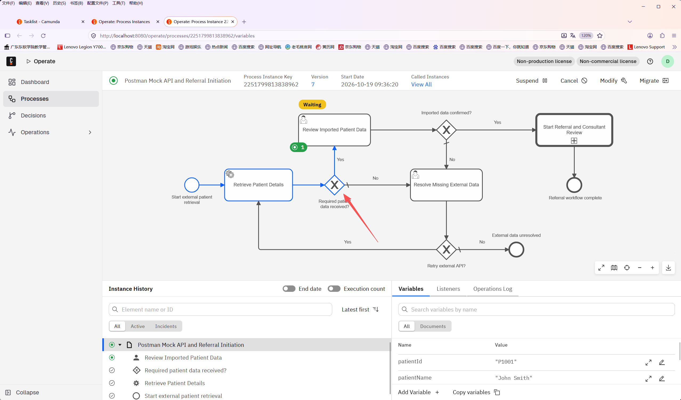
07
UFCEP6 0 3 · Release 2 hospital pathway
External API integration
A local Postman Mock provides a predictable patient response for the BPMN REST connector.
POSTMAN MOCK RESPONSE
CAMUNDA OPERATE RESULT
GET /patients/next returns P1001, John Smith, Cardiology and NEW status.
The REST connector maps JSON fields into process variables and waits for human review.
Evidence: 00_Submission_Supplement/E1_Postman_API_200.png and E2_Operate_API_Review_Waiting.png

Slide 8
08
UFCEP6 0 3 · Release 2 hospital pathway
Java worker to BPMN mapping
Each worker consumes a job type configured on a service task and returns variables used by the next BPMN gateway or user task.
Domain
Worker job type
BPMN service task
Output used by flow
Referral
validate-referral-reference
Validate Referral Reference
referralValidationStatus
Appointment
search-appointment-slot; send-appointment-letter
Search External Scheduling Service; Send Appointment Letter
slotAvailable; letter reference
Finance
process-payment; process-refund
Send Secure Payment Request; Send Approved Refund Request
paymentStatus; refundStatus
Treatment
check-treatment-resource
Check Treatment Lab Imaging Availability
treatmentAvailable
Enquiry
send-clinic-letter
Distribute Clinic Letter
clinicLetterSent
Shared implementation: HospitalExternalWorkers registers the seven production workers; WorkerSupport supplies persistence, logging and retry/error handling.

Slide 9
09
UFCEP6 0 3 · Release 2 hospital pathway
Live demonstration evidence
Use these labels when presenting the complete happy path and controlled exception path to the tutor.
Postman 200 response
Tasklist: resolve external data
E1
Mock API returns the patient JSON payload.
E5
No branch records the missing-data reason and whether to retry.
Operate: API variables
Operate: retry loop
E2
The REST connector has mapped the patient fields and is waiting for review.
E6
Retry = Yes routes the token back to Retrieve Patient Details.
Tasklist: review decision
Operate: unresolved end
E3
User selects Yes or No; this writes the dataConfirmed variable.
E7
Retry = No reaches the External data unresolved end event.
Operate: confirmed flow
E4
Yes branch starts the referral and consultant review subprocess.
E1–E2 are embedded from the current submission evidence. E3–E7 identify the exact Tasklist/Operate views to show during the recorded or live walkthrough.

